Slide 1
Lecture 16: OS Design and RAID
CS343 – Operating Systems
Branden Ghena – Fall 2020
Some slides borrowed from: Stephen Tarzia (Northwestern)

Slide 2
Today’s Goals
Discuss principles guiding OS design.
Describe several classes of OS kernel.
Also:
Explore topic of RAID – redundancy in disks.

Slide 3
Outline
OS Design Principles
Kernel Designs
RAID

Slide 4
Disclaimer
This is the most abstract part of the class
These ideas can take a long time to sink in
Best to introduce them and repeat them

Slide 5
Interface design
Three guiding principles per Tanenbaum
Simplicity
Completeness
Efficiency

Slide 6
1. Simplicity
Simple interfaces are easier to understand and use
“Perfection is reached not when there is no longer anything to add, but when there is no longer anything to take away.” - Antoine de St. Exupéry (French writer and aviator)
Fork() is a great example

Slide 7
Simplicity means avoiding premature optimization
Do not let perfect stand in the way of good
It’s more important to have something working than nothing at all
First step is to make it work “good enough”
Optimization can come later based on usage
Otherwise you might be failing Amdahl’s Law

Slide 8
Simplicity reduces bugs
Interfaces that match expectations end up being used correctly
Features are the source of mistakes
Code that doesn’t exist has no bugs

Slide 9
2. Completeness
Interfaces should make it possible to do everything users need to
Simple things should be simple, difficult things should be possible
For system design, this usually means moving extra functionality into userspace libraries
Managing heap memory is a good example

Slide 10
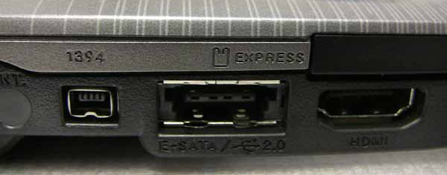
OSes have a long lifetime
OSes in the real world have a tendency towards very long lifetimes
Planning for the future is difficult
Maintaining support for the past is crippling
POSIX standard was created in 1988
3 years before the first webcam
10 years before WiFi
eSata port example

Slide 11
3. Efficiency
Implementations should be efficient
Given simplicity and completeness goals first
Efficiency should meet user’s expectations as well
Which is faster: seek or read?
If it’s not seek, developers are going to write bad code
Also, seek should be cut from the interface (simplicity)

Slide 12
Other OS principles
Two others I want to pull out of the chapter
See textbook for many more lessons and examples
Separate policy and mechanism
Project management is hard

Slide 13
Separation of policy and mechanism
Exemplified in schedulers and virtual memory
Mechanism for switching threads
Policy for when to do so
Could swap out either without changing the other
Be explicit about which is which

Slide 14
Project management is hard
Mythical Man Month
Large projects involve an enormous amount of planning and testing
They are NOT highly parallelizable
The person-month idea is that time and number of developers are exchangeable
In the general case, this is false
Brook’s Law: “Adding manpower to a late software project makes it later.”

Slide 15
Outline
OS Design Principles
Kernel Designs
RAID

Slide 16
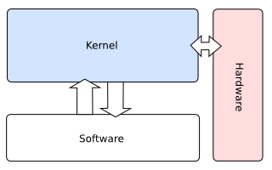
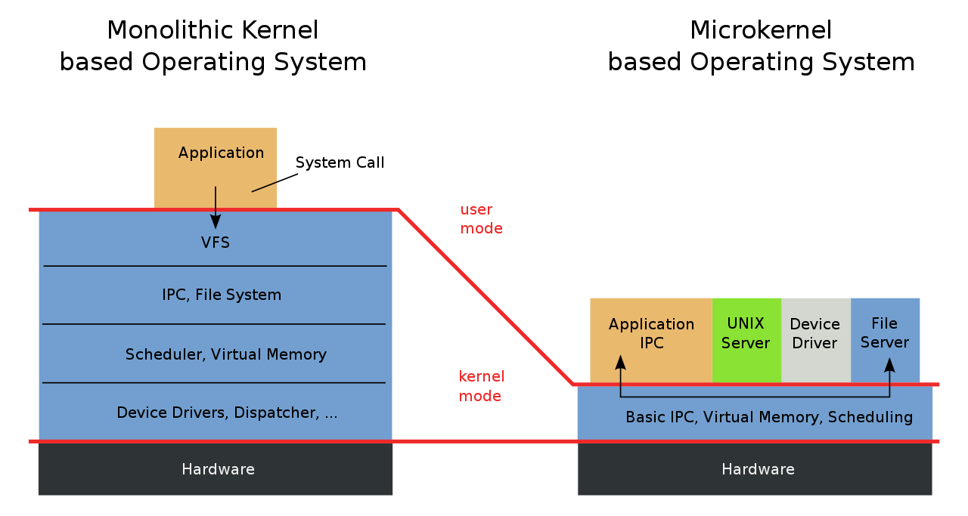
Monolithic kernel
This is the model we have been learning
All OS services occur within the kernel
Applications request service from the kernel
Hardware can only be accessed by the kernel

Slide 17
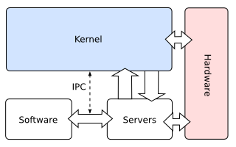
Microkernel
Most services are userspace programs
OS kernel implements minimum features to support them
Requests for services are often Inter-Process Communication (IPC)

Slide 18
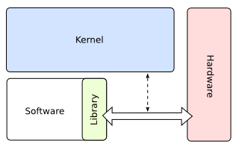
Exokernel
Goal: separate security and abstraction
OS should provide security only
Everything else goes in applications
If an application is allowed to access a certain region of the disk
Monolithic: constrain it to a particular filesystem included in the kernel
Exokernel: give it raw access to those disk blocks and it can decide
Application libraries can implement filesystem stuff
Upside: applications can be more efficient
A downsides: surrenders “look and feel” of the system

Slide 19
Hybrid kernels
Most real operating systems are not any of these extremes
But exhibit qualities for each as desirable
Often some lowest level drivers are in the kernel
But higher level stuff are userspace services
Example: the OS needs to support USB
But printers can be run as services
Example: heap region is given to programs to manage
Libraries like malloc can manage it in userspace

Slide 20
Outline
OS Design Principles
Kernel Designs
RAID

Slide 21
Failure rates for disks are a serious problem
Problem: disks fail
HDDs have physical actuators that wear out
SSDs have limited numbers of writes
Big problem: servers have many disks
Assume rate of failure per year of disk is 1%
And failures aren’t correlated
And a server has 264 disks
What are the odds that a disk will fail this year?
1 – (1 – 0.1)²⁶⁴ = 93% odds that at least one disk will fail

Slide 22
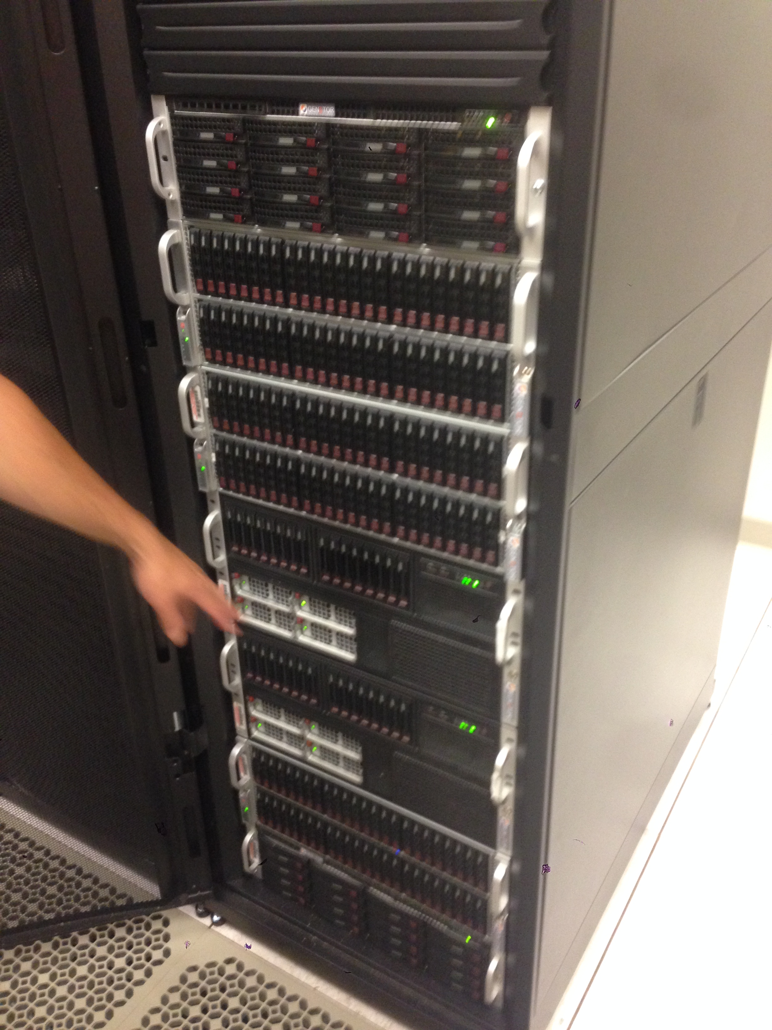
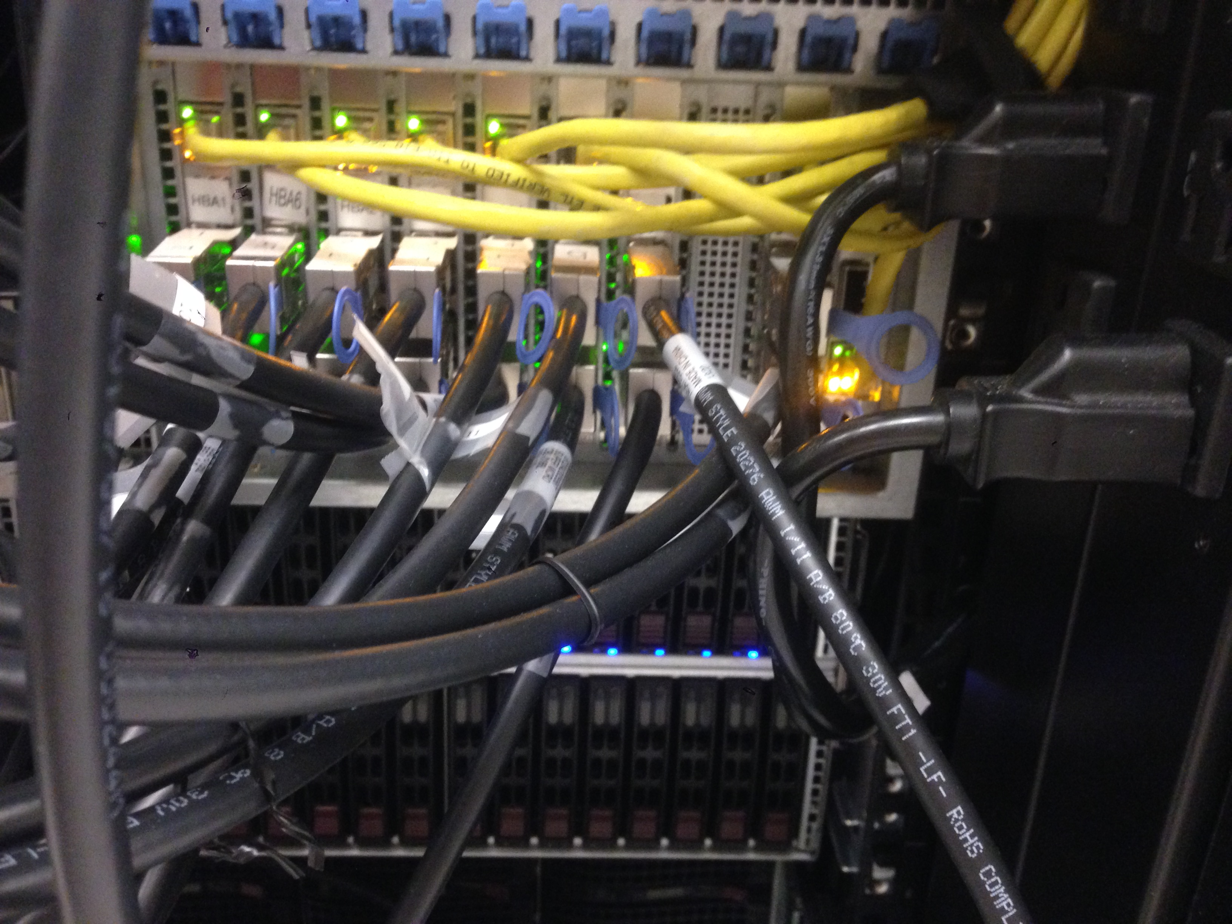
Database server at Northwestern
264 fast (10k RPM) magnetic disks (for production)
56 slow (7200 RPM) magnetic disks (for backup)
~150 TB storage capacity
Comprised of 6 physical chassis (boxes) in one big cabinet, about the size of a coat closet.

Slide 23
Redundant Array of Independent Disks (RAID)
Observation in 1988 (Patterson, Gibson, Katz)
Servers could use high-quality mainframe disk drives
OR
Servers could use several redundant consumer disk drives
Furthermore array of disks improves multiple things at once
Reduce impact of a failure by storing data redundantly on multiple disks.
Increase capacity by making multiple disks available to store data.
Increase throughput by accessing data in parallel on multiple disks.

Slide 24


Basic idea of RAID
Combine many disks to create one superior virtual disk.
The RAID array provides the same interface as a single disk.
OS thinks it’s dealing with this:
But it’s just an illusion. The reality is:
Sector r/w requests
Sector r/w requests
RAID virtual disk
RAID controller

Slide 25
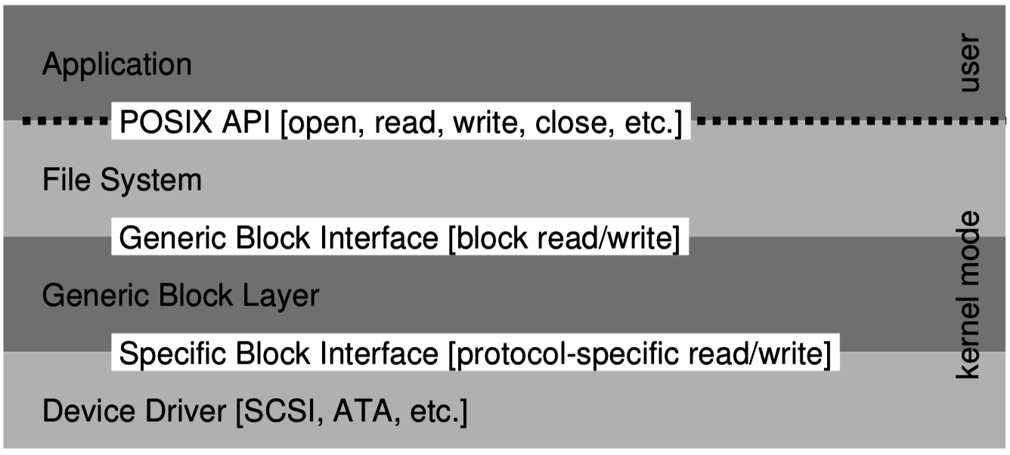
How does RAID fit into the OS?
RAID can be implemented in software or hardware
Software RAID means that the OS is responsible for assembling multiple disks into a RAID.
Implements a generic block device.
Hardware RAID requires a specialized controller card that coordinates the multiple disks, presenting interface of one disk.
OS just needs a driver for the RAID controller, like any other disk controller.

Slide 26
RAID levels
RAID 0 – Striping:
Distribute data across 2 disks for twice the peak throughput.
RAID 1 – Mirroring:
Copy data onto 2 disks to tolerate failure of one.
RAID 4/5/6 – Parity:
Keep parity bits around for each block to check for errors and rebuild.
Typically involves 3+ disks.

Slide 27
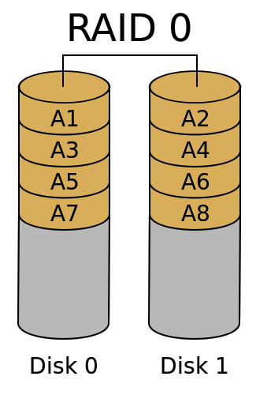
RAID 0 – Striping (for throughput and capacity)
Divide the logical disk into chunks
(A1, A2, A3 …) 1 or more blocks in size
Distribute the chunks regularly over two or more (N) physical disks.
(+) Throughput for both random and sequential access scales with N.
T_{RAID0} = N * T_{disk}
(+) Capacity also scales by N.
(+) Cost per byte is identical
(–) But Mean Time To Failure is worse because failure of a single disk is catastrophic:
MTTF_{RAID0} = MTTF_{disk}/N

Slide 28
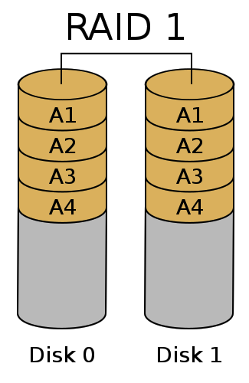
RAID 1 – Mirroring (for fault tolerance)
Duplicate each chunk on each of N physical disks.
(+) It is impossible to lose data unless all disks fail simultaneously.
i.e., failure window is reduced to the time it takes to replace a broken disk.
(–) Write throughput is not improved
(–) Capacity is the same as a single disk
(–) Cost per byte is greater
$_{RAID1} = N * $_{disk}

Slide 29
Check your understanding – RAID 1
(–) Write throughput is not improved
Is write throughput reduced in RAID 1? Or is it the same as a single disk?
What about read throughput?

Slide 30
Check your understanding – RAID 1
(–) Write throughput is not improved
Is write throughput reduced in RAID 1? Or is it the same as a single disk?
Same as a single disk
Write can go to both disks in parallel
What about read throughput?
Better than a single disk
Can read two different blocks at once!

Slide 31
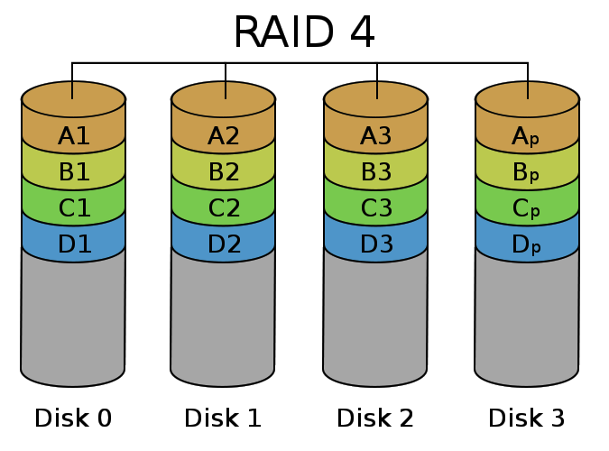
RAID 4 – Parity (for fault tolerance, capacity & throughput)
Distribute the chunks across the first (N-1) disks.
On the N^{th} disk, store a corresponding parity chunk.
Parity block is redundant data about a set of chunk (a stripe)
Can tolerate loss of any one disk
Parity disk becomes bottleneck for writes limiting throughput
Redundant data

Slide 32
How does parity work?
Even parity – add a 0 or 1 such that the total number of 1’s is even.
There also exists odd parity which makes the total number of 1’s odd
Examples (Even Parity):
0b0000_0000 – zero ones -> parity bit = 0
0b1111_1111 – eight ones -> parity bit = 0
0b0110_1101 – five ones -> parity bit = 1
If a single bit is lost, the parity bit allows us to infer the value of the lost bit

Slide 33
Check your understanding – Parity Recovery
What are the values of the missing bits?
[0, 0, 1, 0, ?, 0, 1, 1] – Even Parity: 1
[0, ?, 1, 1, 1, 0, 0, 0] – Even Parity: 0

Slide 34
Check your understanding – Parity Recovery
What are the values of the missing bits?
[0, 0, 1, 0, ?, 0, 1, 1] – Even Parity: 1
Value must be a 0
Because parity plus ones is already even
[0, ?, 1, 1, 1, 0, 0, 0] – Even Parity: 0
Value must be a 1
Because parity plus ones is not currently even

Slide 35
Parity can only fix a single error
What if two bits are missing?
[?, 0, 1, 0, ?, 0, 1, 1] – Even Parity: 1
Could both be zeros
Could both be ones
Impossible to tell which
More advanced “error correcting codes” are possible to detect/fix two or more errors
Hamming Code (single error correcting, double error detecting)

Slide 36
Parity chunk in RAID
Disk 0 | Disk 1 | Disk 2 | Disk 3 (parity)
0001 0010 1100 1100 | 0000 1111 0000 1111 | 1101 1111 0011 0001 | 1100 0010 1111 0010
1111 1111 1111 1111 | 0001 0001 0001 0001 | 1101 1001 0110 0110 | 0011 0111 1000 1000
0000 0000 0000 0000 | 1101 1011 0011 0011 | 1111 0011 0011 1000 | 0010 1000 0000 1011
Redundancy overhead
Useful storage capacity
Parity is computed bit-wise across corresponding chunks.
Chunks are one or more blocks (multiple of 4 kB) in size
Writing a small file will involve one disk plus the parity disk.
(parity disk can become a bottleneck)
Writing a large file will involve all the disks.

Slide 37
Rebuilding an array after failure
Disk 0 | Disk 1 | Disk 2 | Disk 3 (parity)
0001 0010 1100 1100 |  | 1101 1111 0011 0001 | 1100 0010 1111 0010
1111 1111 1111 1111 |  | 1101 1001 0110 0110 | 0011 0111 1000 1000
0000 0000 0000 0000 |  | 1111 0011 0011 1000 | 0010 1000 0000 1011
Disk failed!
If a disk fails, then we remove it and replace it with a working disk.
Then scan through the entire array to compute and write missing data.
This is called “rebuilding” the array
We cannot tolerate another disk failure until rebuild completes.
Reads/writes can continue while array is rebuilding!

Slide 38
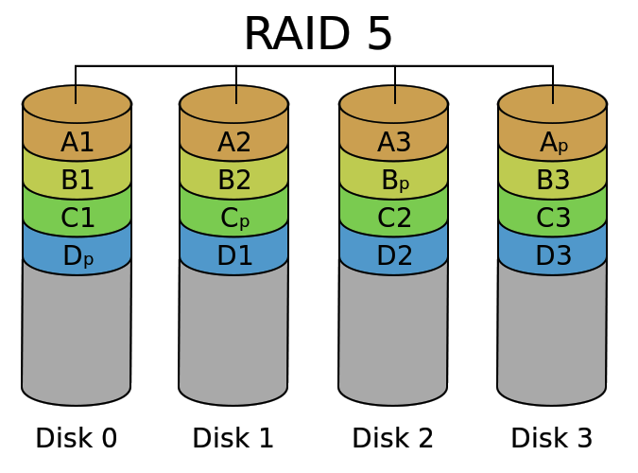
RAID 5 – Distributed Parity (the winner in practice)
Distribute parity chunks across the disks, to avoid a small-write bottleneck
(+) Failure of one disk is OK
(+) Throughput is good
T_{RAID5} = (N-1) * T_{disk}
(+) Cost per byte is good
$_{RAID1} = N/(N-1) * $_{disk}
(–) High overhead for small N
(–) Failure risk is high for large N
N is typically 3 to 8

Slide 39
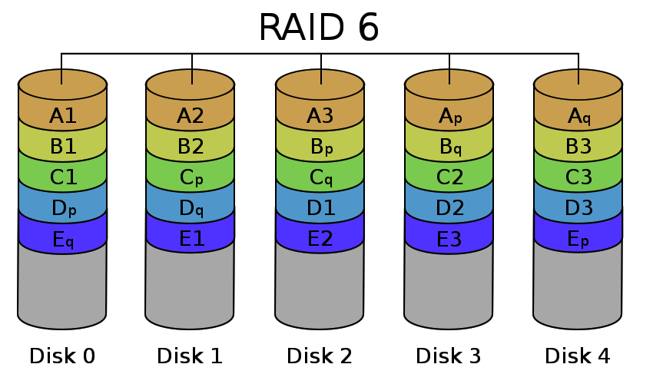
RAID 6 – Double Parity (for large arrays)
Add another disk and keep two parity chunks per stripe
2nd parity is computed differently
(+) Failure of two disks is OK
(~) Throughput is less:
T_{RAID5} = (N-2) * T_{disk}
(~) Cost per byte is higher:
$_{RAID1} = N/(N-2) * $_{disk}
Makes sense for larger N (>8)

Slide 40
Outline
OS Design Principles
Kernel Designs
RAID

